Slide 1
Retaining Key Information under High Compression Ratios: Query-Guided Compressor for LLMs

Slide 2
Issuses
Retrieve many documents using RAG which makes number of input token large.
Performance decreases while compression ratio increasing.
The former compression cannot keep the key information and the importance of key information is proved in this essay.

Slide 3
Contributions
High compression ratios by retaining most query-related information during compression
Low training costs by optimizing the compressor only instead of finetuning the entire LLM
better semantic consistency by compressing the n-gram structure rather than deleting words.

Slide 4
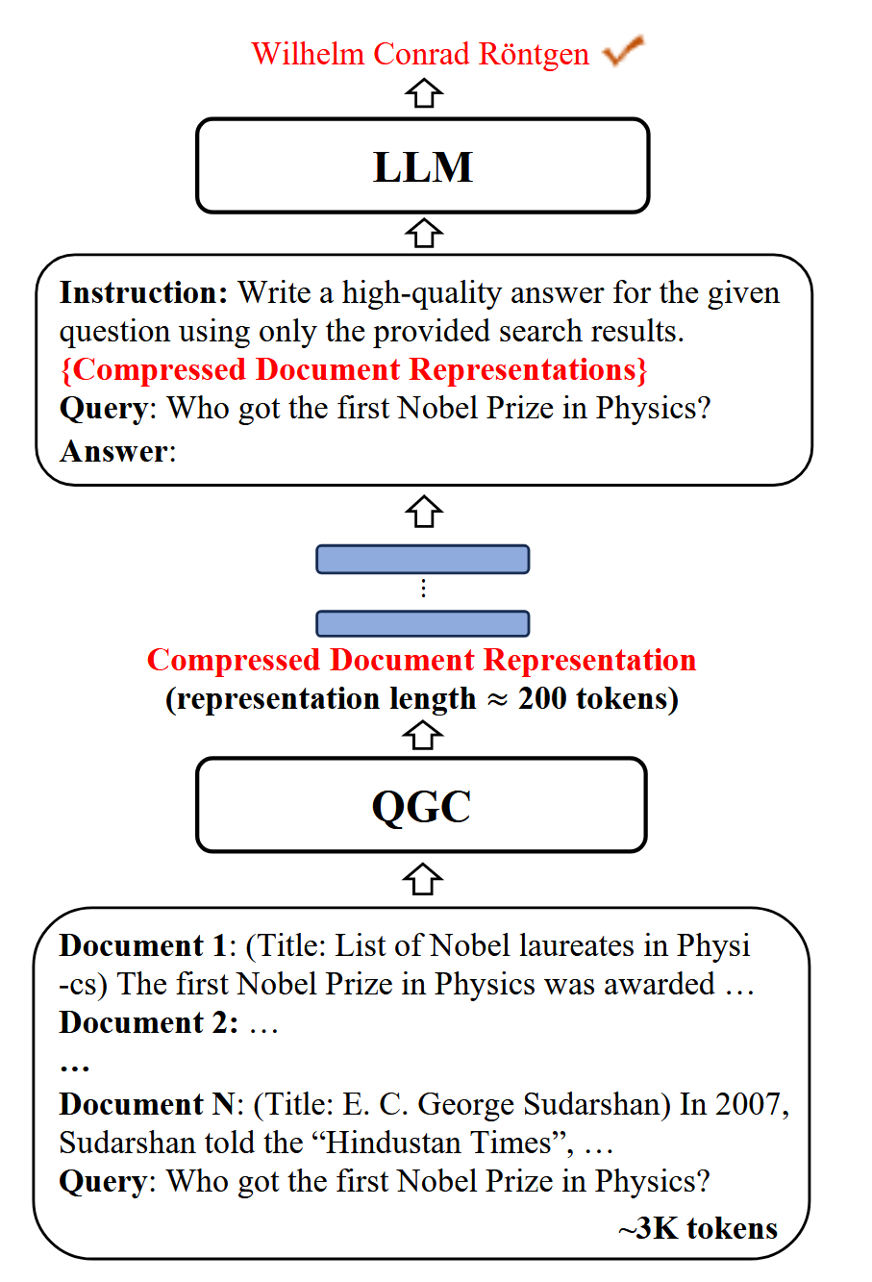
Effect

Slide 5
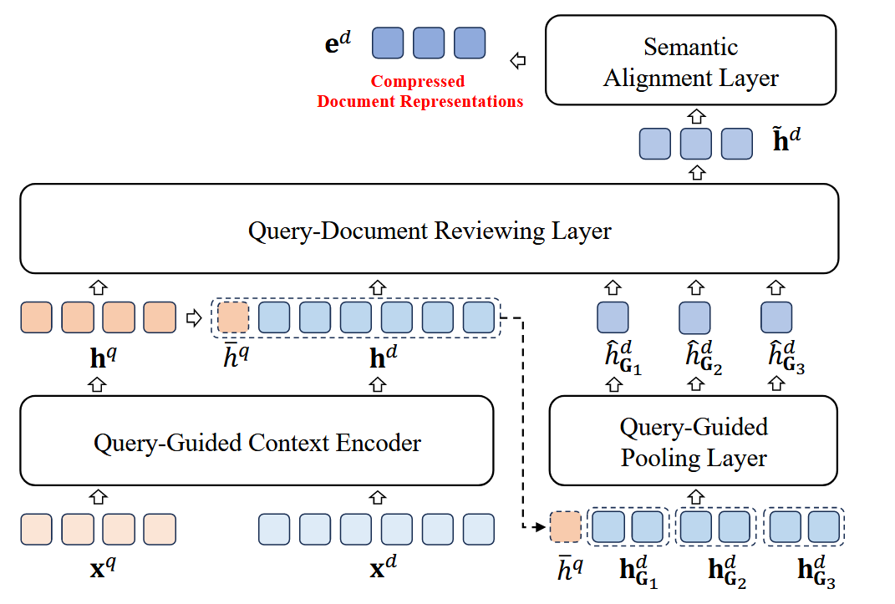
QGC Structure

Slide 6
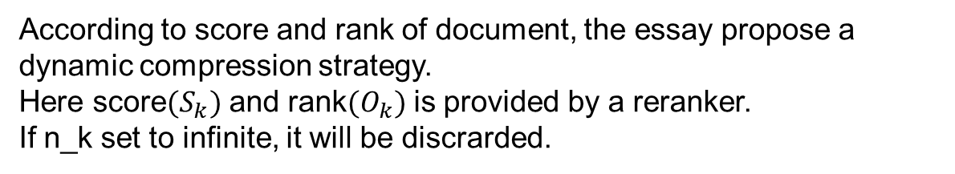
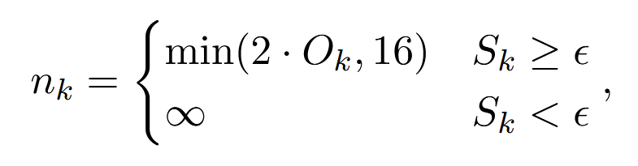
Dynamic compress strategy

Slide 7
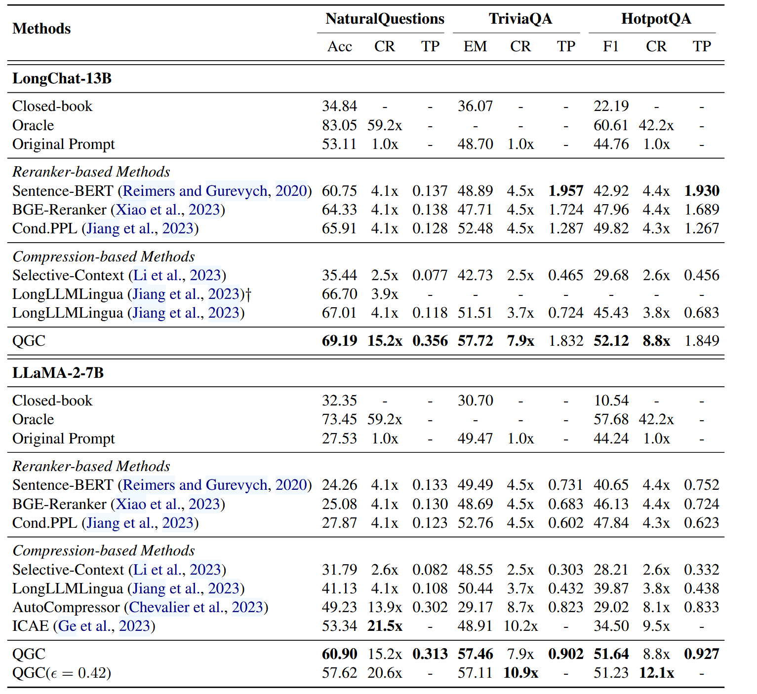
Experiment result

Slide 8
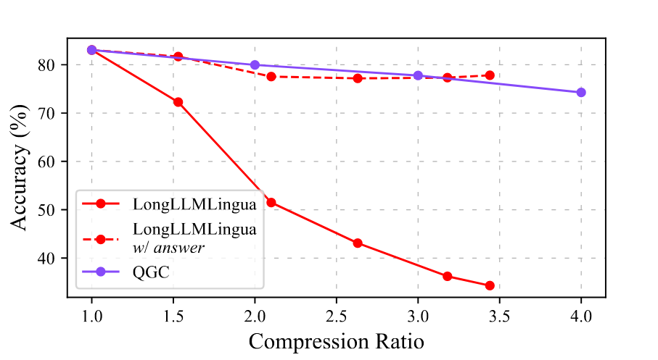
Other experiments

Slide 9
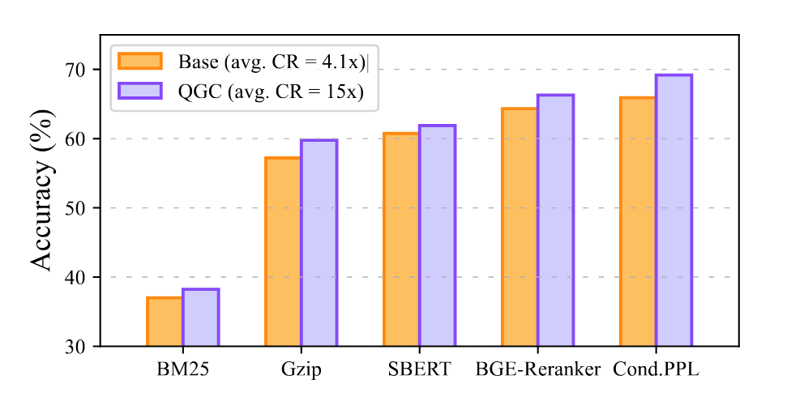
Other experiments

Slide 10
N-gram
bigram-(n=2)
Essay sharing is set on Sunday evening.→ (Essay sharing), (sharing is ), (is set),(set on), (on Sunday), (Sunday evening)
trigram-(n=3)
→ (Essay sharing is),(sharing is set), (is set on), (set on Sunday), (on Sunday evening)

Slide 11
N-gram
Test example
The essay sharing is scheduled for Sunday evening.
For bigram, (The essay), (essay sharing), (sharing is), (is scheduled), (scheduled for), (for Sunday), (Sunday evening)

Slide 12
N-gram
For trigram
The essay sharing is scheduled for Sunday evening
(The essay sharing), (Essay sharing is), (Sharing is scheduled), (Is scheduled for), (Scheduled for Sunday), (For Sunday evening)

